Slide 1

1 Month Internship at Foresight BI & Analytics
FORGGITH PHARMACEUTICALS

Slide 2
Content
Sr No | Content
1 | Company Overview
2 | Problem Statement
3 | Sales Performance Overview
4 | Marketing Performance Overview
5 | Report Mockup
6 | Skills
7 | Data Cleaning & Transformation
8 | Data Model
9 | Dashboard
10 | Insights
12 | Conclusion
13 | Certificate

Slide 3
Company Overview
Forggith Pharmaceuticals, based in Germany, manufactures medical drugs sold to distributors, not directly to retailers or end-users. Distributors submit monthly sales data to Forggith, which is used for reporting and KPI tracking.
Forggith's Sales and Marketing team ensures that retailers receive products through distributors, supporting growth and achieving sales and marketing objectives.

Slide 4
Problem Statement
Forggith needs an effective way to visualize and analyze their sales and marketing data to evaluate performance, identify trends, and make data-driven decisions.
The primary goal is to assess the effectiveness of their strategies across distributors and retailers and adjust tactics to improve outcomes. To achieve this, they aim to develop Power BI reports that provide insights

Slide 5
Sales Overview
Sr No | Sales Performance Overview | Explanation
1 | Total Revenue | The overall revenue earned during the selected period.
2 | Total Revenue Year To Date (YTD) | Total revenue earned from the start of the year up to today.
3 | Total Revenue Previous Year YTD | Revenue earned from the start of last year up to the same date as today.
4 | Total Revenue Same Period Last Year(SPLY) | Revenue earned during the same period in the previous year.
5 | Total Target YTD | The revenue goal set from the start of the year up to today.
6 | Total Target | The overall revenue goal set for the period.
7 | Actual Revenue Performance YTD vs Target YTD | How current YTD revenue compares to the YTD target.
8 | Revenue Month on Month Percentage Change | The percentage change in revenue compared to the previous month.
9 | Revenue Distribution by Location | Revenue breakdown by different locations or regions.
10 | Revenue by Channel | Revenue earned from different sales channels
11 | Revenue by Product Class | Revenue breakdown by product categories or types.

Slide 6
Marketing Overview
Sr No | Marketing Performance Overview | Explanation
1 | Revenue Achieved vs Revenue Target | Compares actual revenue earned with the set revenue goal.
2 | Volume Achieved vs Volume Target | Compares actual sales quantity with the set quantity goal.
3 | Actual Revenue by Sales Representative | Shows the revenue generated by each sales rep.
4 | Target Revenue Achievement% by Sales Representative | Percentage of revenue target achieved by each sales rep.
5 | Actual Volume by Sales Representative | Displays the sales quantity achieved by each sales rep.
6 | Target Volume Achievement by Sales Representative | Percentage of sales quantity target met by each sales rep.
7 | Actual Revenue Achievement by Sales Team | Total revenue achieved by the entire sales team.
8 | Revenue and Volume Achievement by Product. | Shows revenue and quantity sold for each product compared to their targets.

Slide 7
Objective(Goal & Purpose need to be Achieved)
The Sales Representative can track their performances through-out the periods to plan their marketing activities.
The Team Managers can track their teams' performances through-out the periods to plan their teams' activities.
Executive team can track Revenue numbers to monitor alignment with the set targets to influence medium to long term strategies.

Slide 8
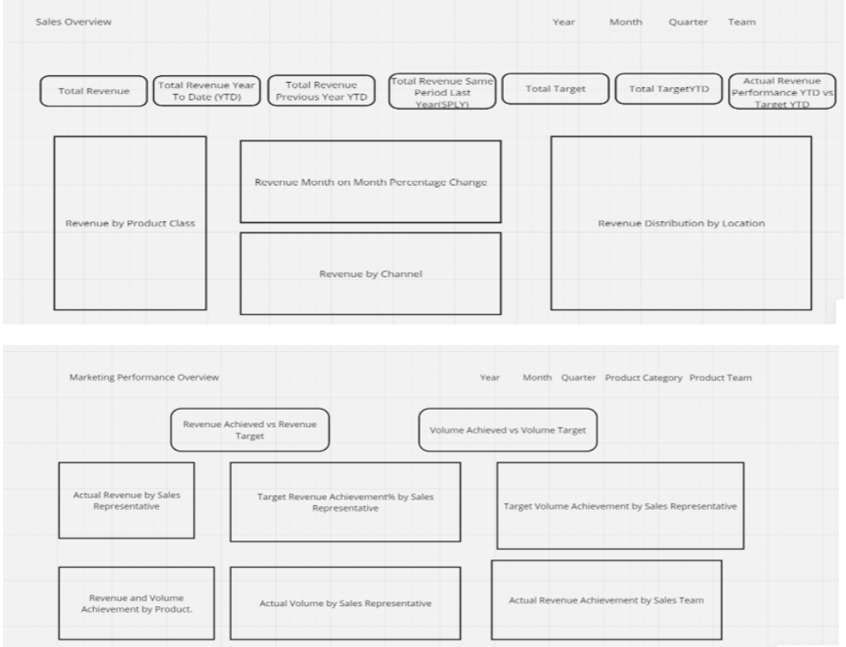
Report Mockup

Slide 9
Skills
The analysis was performed using Microsoft Power BI, utilizing the following key concepts:
DAX (Data Analysis Expressions): Used to create calculated measures for advanced data analysis.
Power Query Editor: Used for data cleaning
Data Modeling: Created one-to-many relationship between the different tables.
Bookmarking
Page Navigation
Filters
Tooltips

Slide 10
Data Cleaning & Transformation
Used the Append query to append the Sales 2022 table with Sales 2023–2025 fact tables
Used the Merge query to merge the DimProduct table with the Sales 2022–2025 fact table
Removal of errors and duplicates present in the data for each table and column
Checked for blank cells or missing values in the dataset
Correction of data types, especially dates
Reduction of decimal places in columns having currency values
A calendar table was created for time intelligence calculations

Slide 11
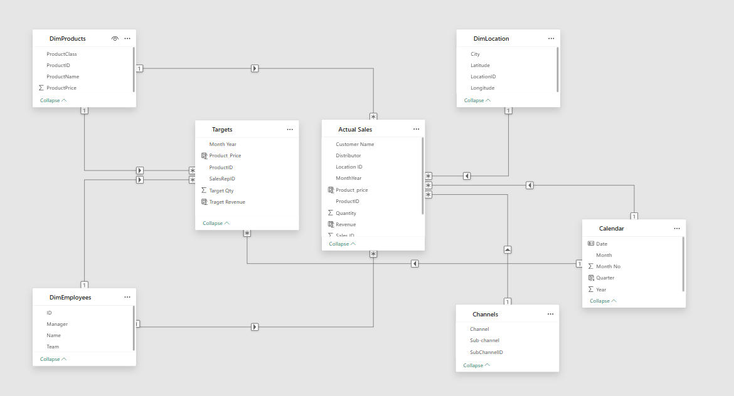
Star Schema Data Model

Slide 12
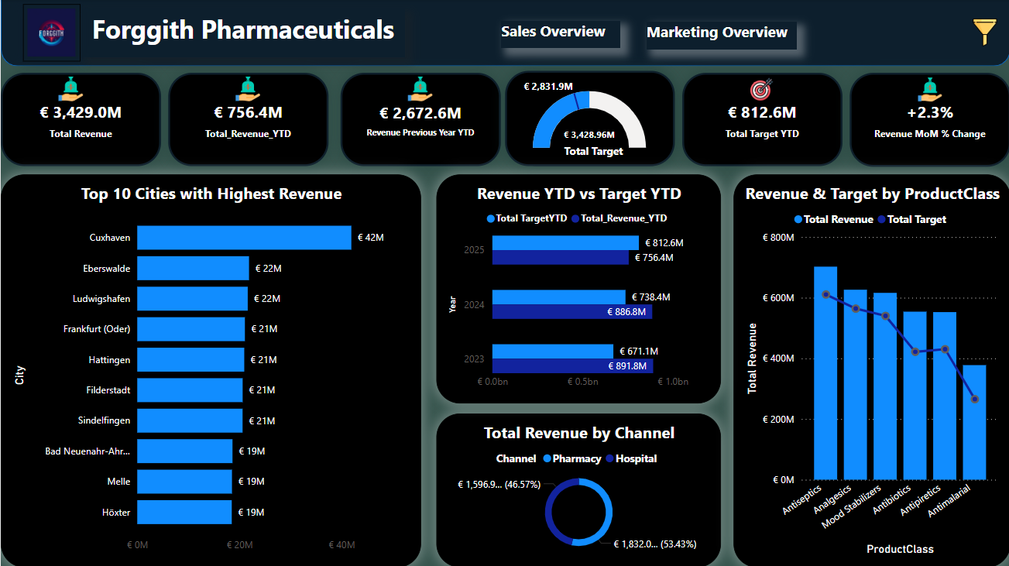
Sales Dashboard

Slide 13
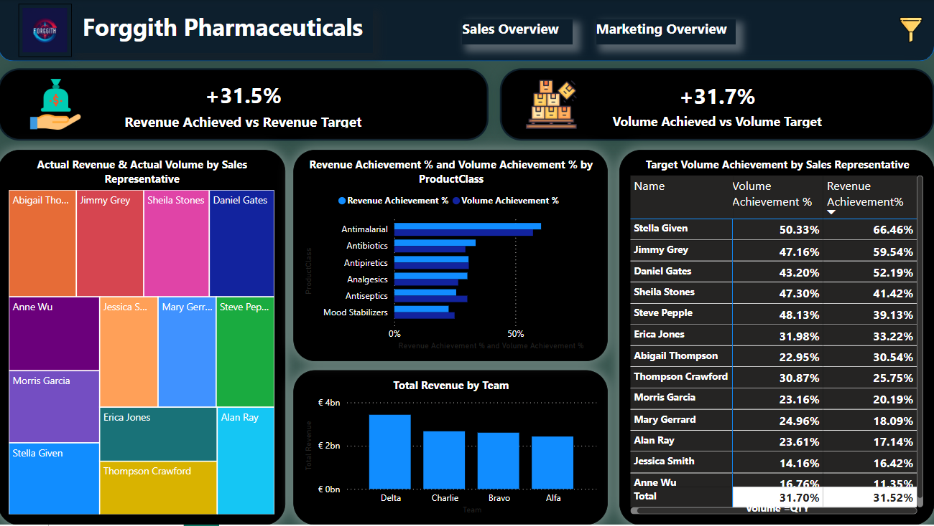
Marketing Dashboard

Slide 14
Insights
Overall, the target revenue was met and exceeded by 31.5%.
However, based on individual performance in the current year (2025), Delta Team did not meet their target revenue as well as Volume Target.
In total, over €11,118.1 million was earned from 2022 to 2025, surpassing the target of nearly €8,453.3 million.
Stella Given achieved the highest revenue and product volume sold among all sales reps.
Team Delta led in overall marketing performance.
Antimalarial were the best-performing product class.
The Pharmacy channel outperformed the Hospital channel in total sales.

Slide 15
Conclusion
The analysis has provided valuable insights that can help the organization make informed decisions to assist in guiding their strategies, tactics, and operations as a company.
By addressing the key issues identified in the analysis, the organization can achieve their Sales and Marketing goals:
The Sales Representatives can track their performance over time
The Team Managers can monitor their teams' performance
The Executive Team can track Revenue numbers to ensure alignment with set targets

Slide 16
Thankyou😊

